Slide 1






On-Campus Event Management System
Aakash Belide
Andi Wang
Julio Sepulveda
Monesha Balasambandam
Xiangchao Hao

Slide 2


Project and it’s Purpose
Background:
Northeastern University hosts various events like workshops, seminars, and hackathons, requiring efficient management. A centralized event management system simplifies organizing, registering, and financing these events. By digitizing event processes, it streamlines participant data handling, communication, logistics, and promotions. Additionally, it ensures data privacy and security, safeguarding participant information.
Purpose:
User-Centric Design The system focuses on an intuitive user experience, allowing event hosts to manage event details, participant lists, logistics, and attendee demographics to enhance event planning and attract sponsorship.
Comprehensive Features It offers tools for event creation, scheduling, participant management, finance tracking, ticketing, marketing, and data analysis, streamlining all aspects of event management.
On-Campus Focus Catering exclusively to campus events, from small meetups to university-wide conferences, the system ensures inclusivity and effectiveness within the Northeastern University community.
1
2
3

Slide 3
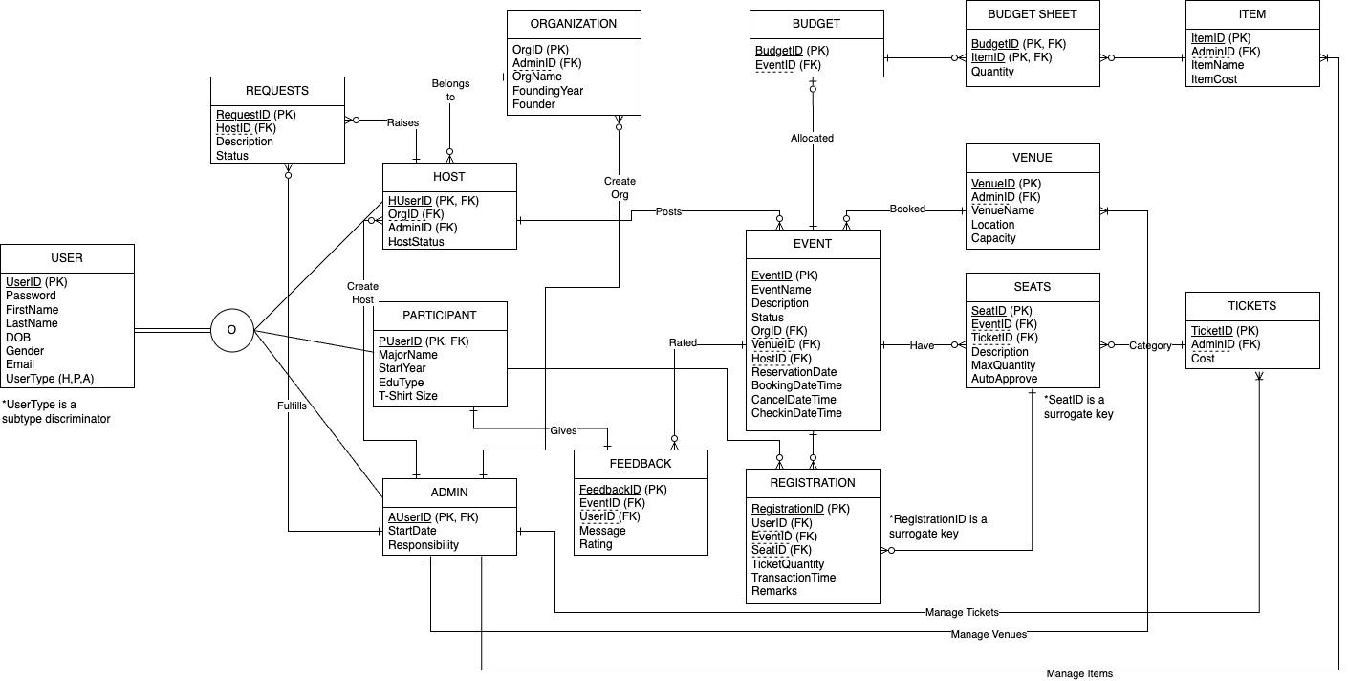
Entity Relationship Diagram (ERD)

Slide 4
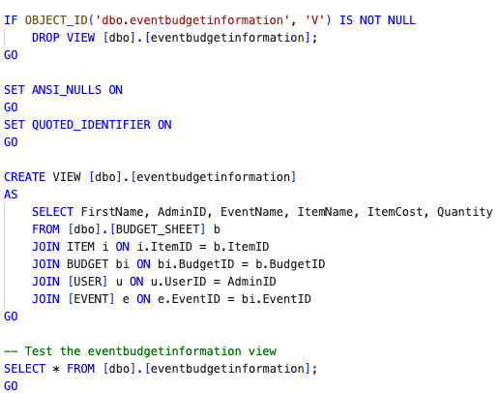
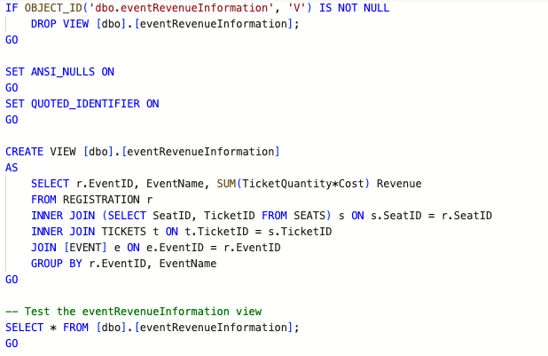
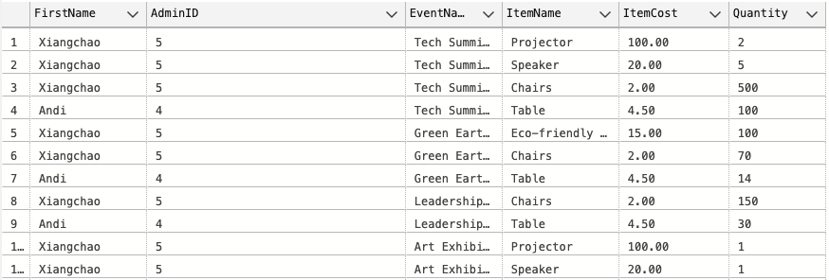
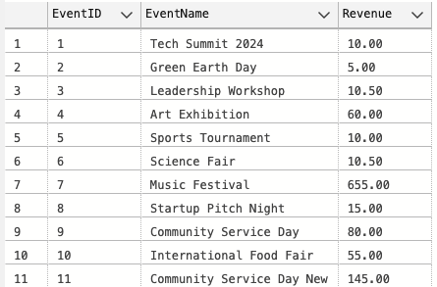
Views
eventbudgetinformation: This view shows event information along with its budget and item cost for items ordered for that event.
eventRevenueInformation: This view shows event wise revenue.
Output:
Output:

Slide 5
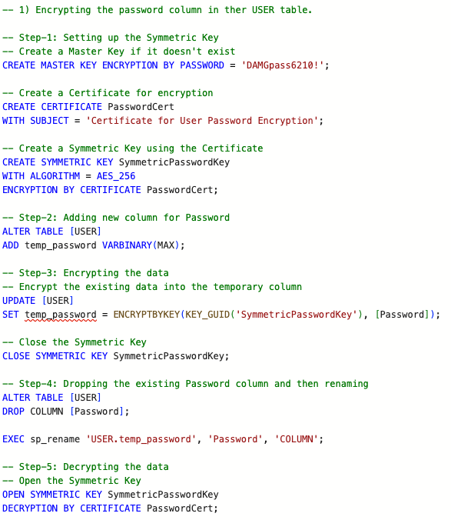
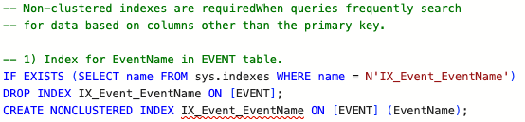
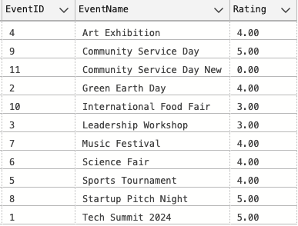
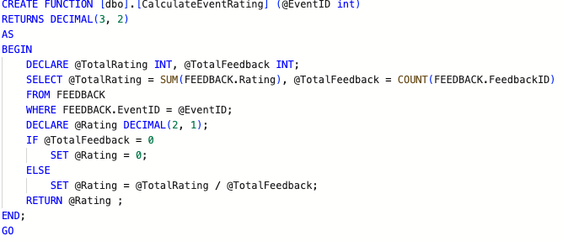
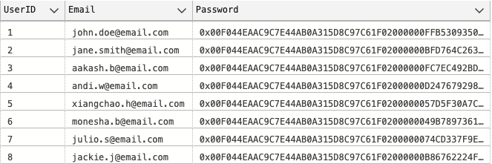
Encryption
Non-Clustered Index
User Defined Functions
CalculateEventRating;
This UDF calculates the event rating based on the passed EventID.
Output:
Output:

Slide 6
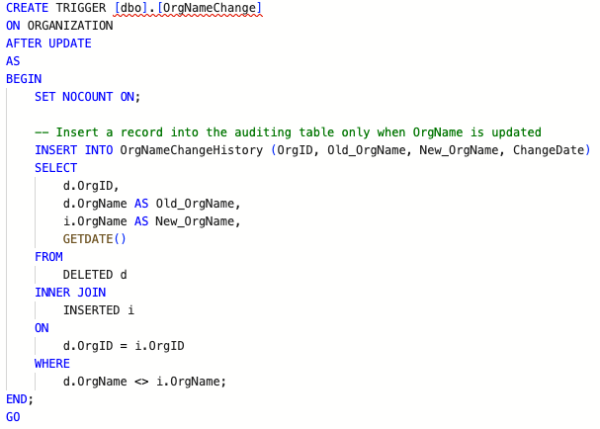
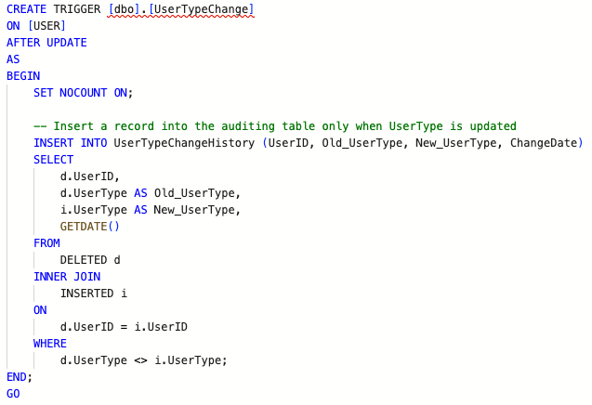
Triggers
OrgNameChange: This trigger captures whenever an Organization name is changed.
UserTypeChange: This trigger captures whenever UserType associated to a user is changed.

Slide 7
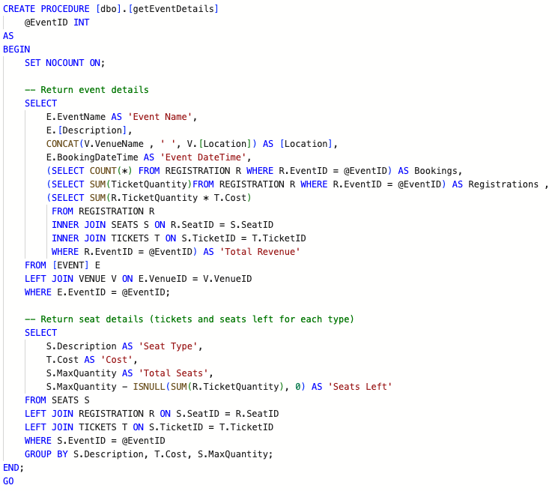
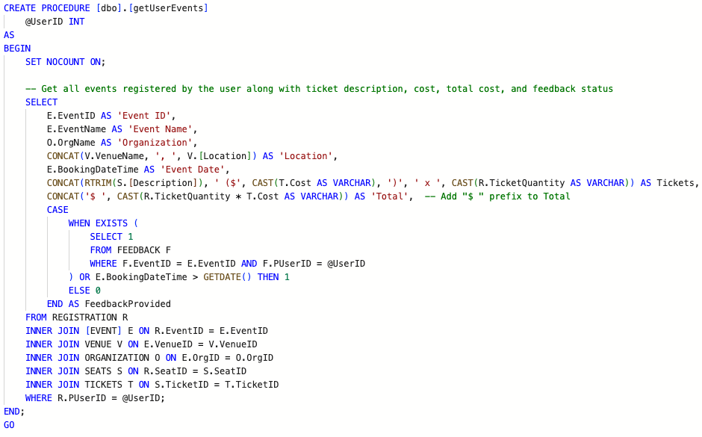
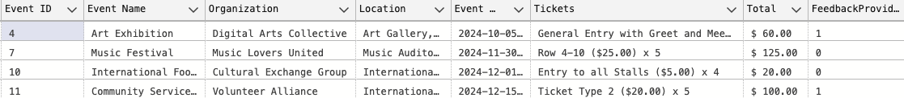
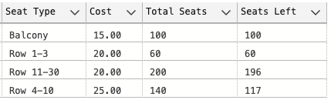
Stored Procedures
getEventDetails: This stored procedure gets all the events and the tickets associated with it that a user has registered for.
getUserEvents: This stored procedure gets all the events and the tickets associated with it that a user has registered for.
Output:
Output:

Slide 8
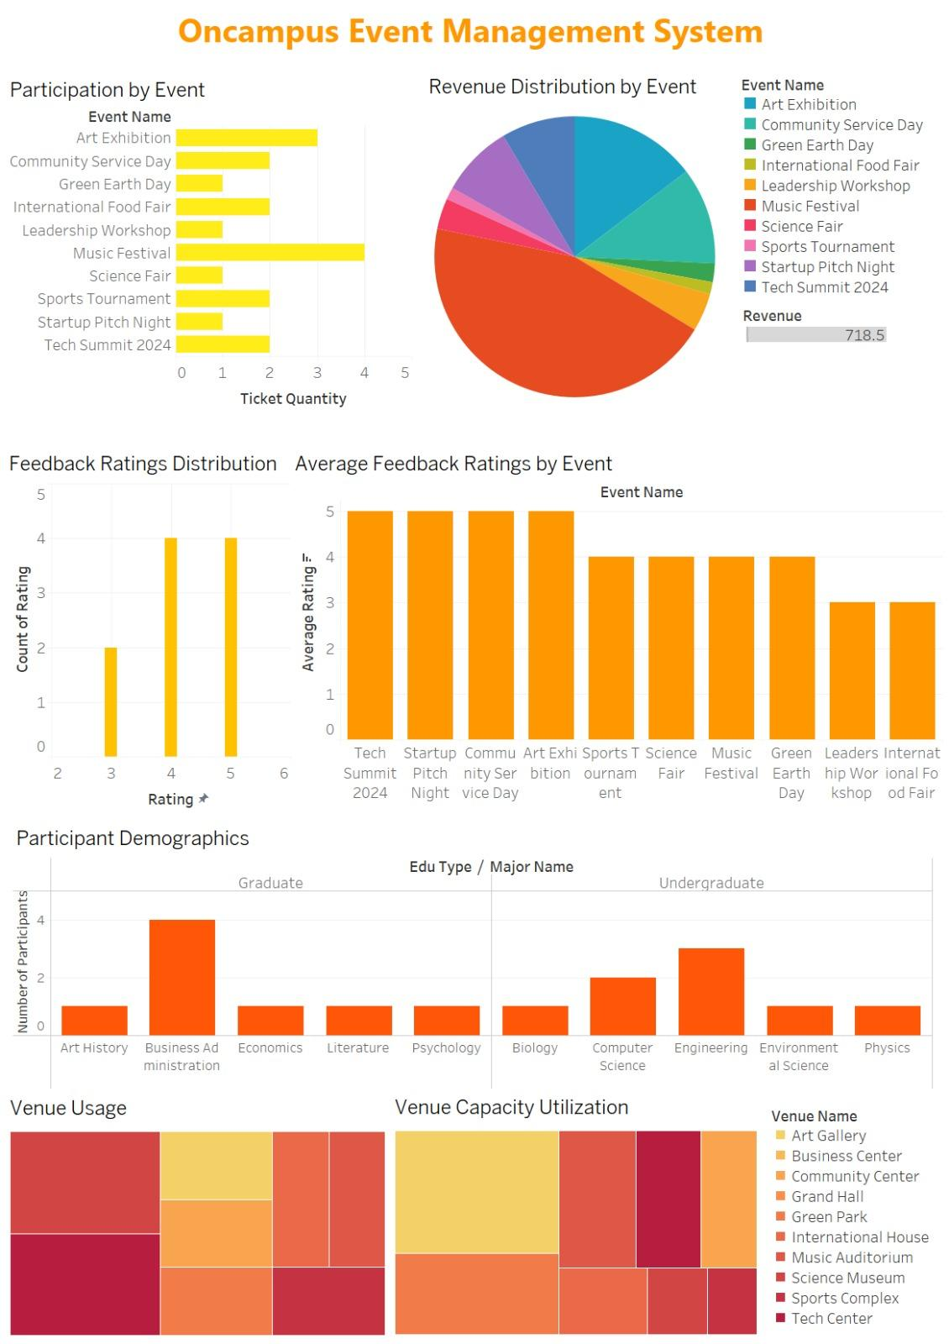
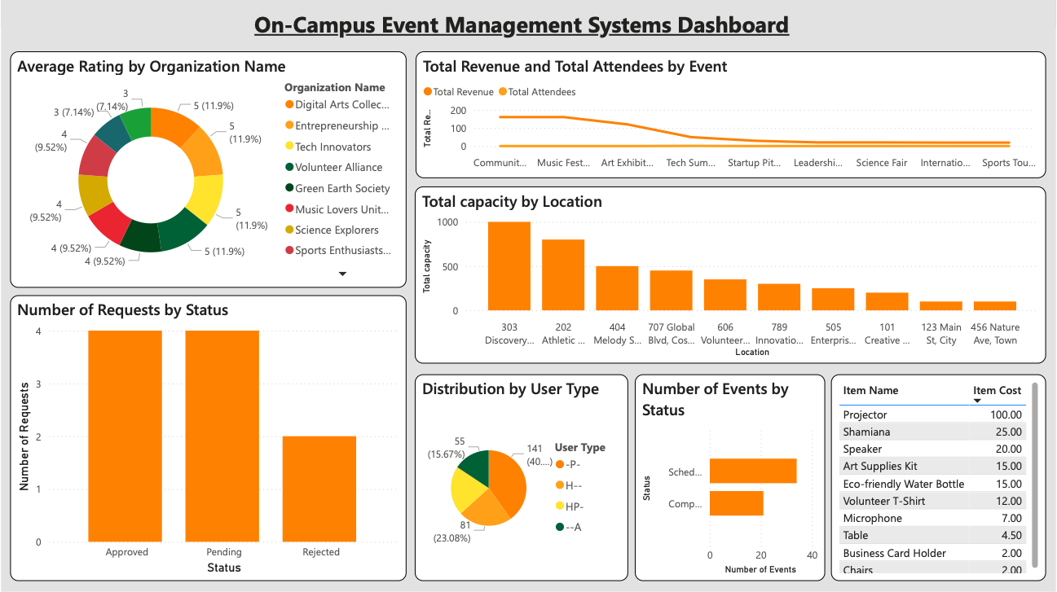
Visualizations
Tableau:
PowerBI:

Slide 9
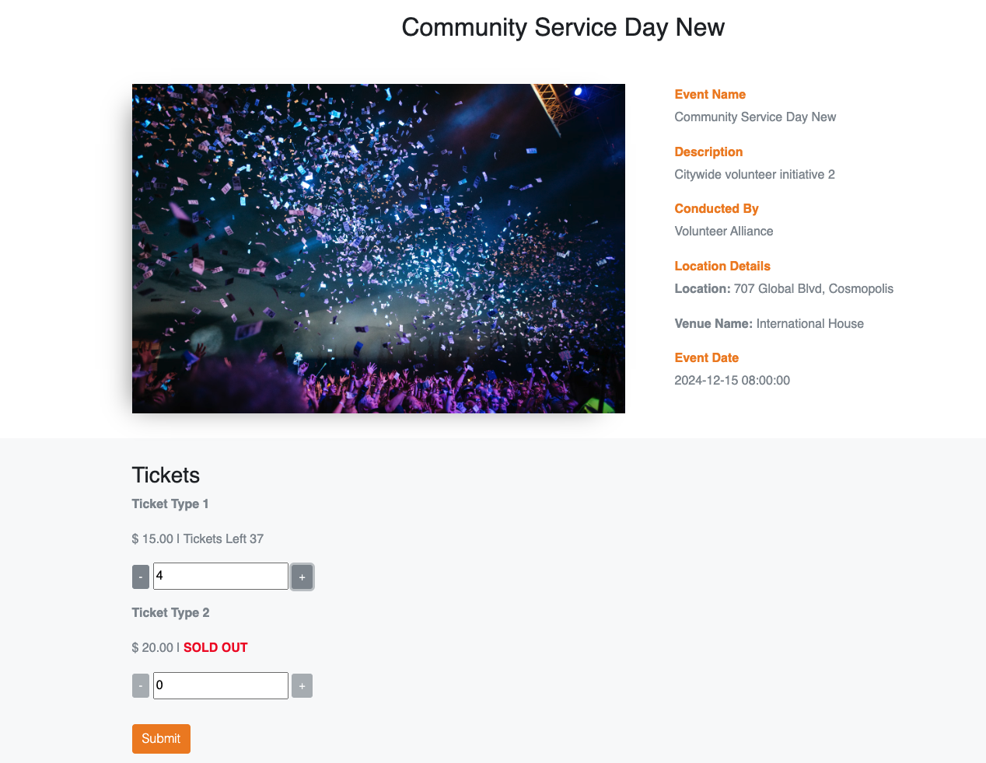

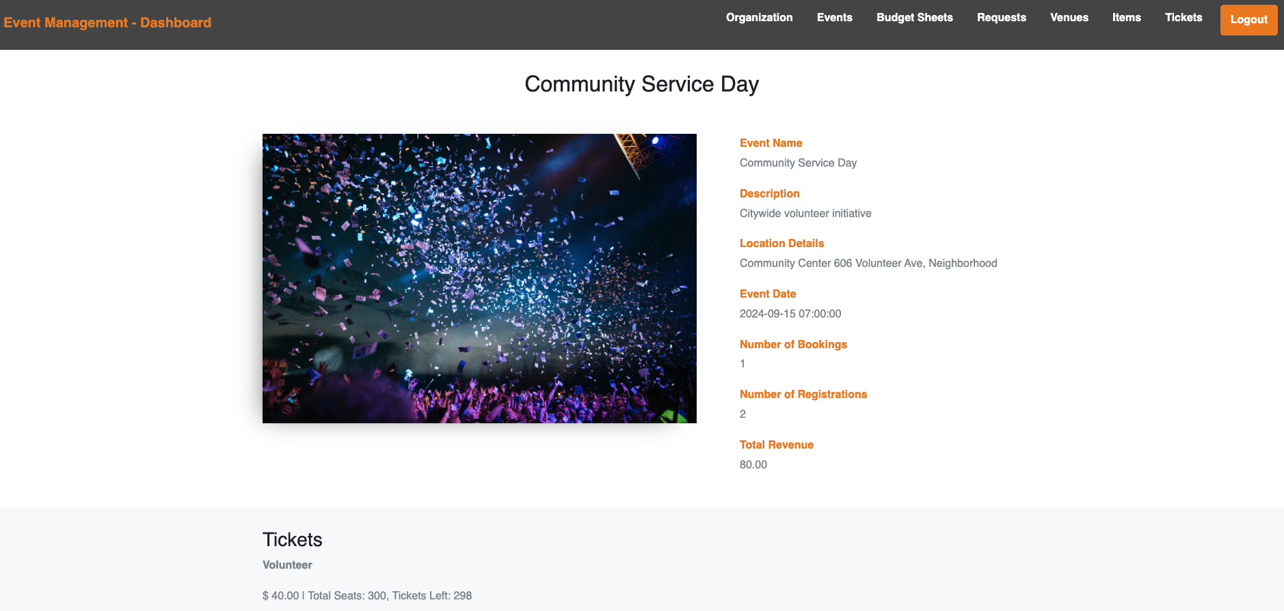
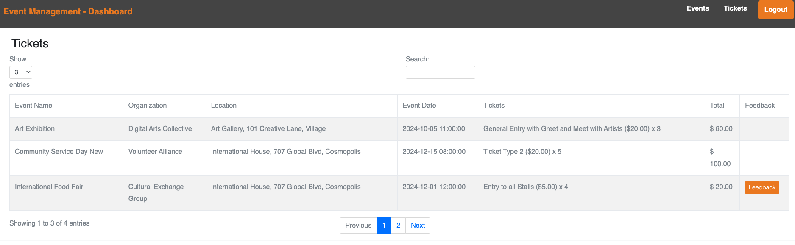
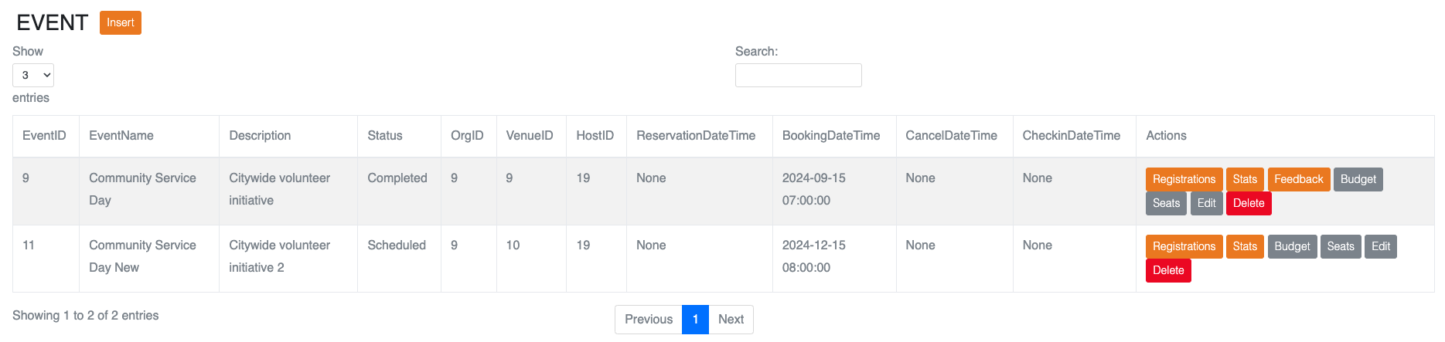
GUI

